Slide 1
Annual Evaluation Report Highlights FY 2022-23
Applied Survey Research (ASR)
December 13, 2023

Slide 2
Agenda
Strategic Framework
FY 2022-23: a “gap year” between previous and new strategic plan
New Areas of Focus
New Priority Populations
Evaluation Updates
Discuss Evaluation Goals and Reports from FY 2022-23
Evaluation Highlights
FIRST 5 team to share key highlights from the FY 2022-23 evaluation report

Slide 3
Strategic Framework (gap year)

Slide 4
Strategic Plan Areas of Focus
First 5 spent ten months engaging with our Commissioners, community partners, early educators, parents, and staff to design a new Strategic Plan.
The updated Strategic Plan includes four key areas that frame our work:
Connecting families to affordable, quality supports and services that meet children’s basic needs and safety.
Engaging families in the work of FIRST 5, including advocacy and leadership opportunities
Promoting diversity, equity, inclusion, and belonging at FIRST 5
Strengthening the diverse workforce that supports young children and families

Slide 5
Strategic Plan Priority Populations
FIRST 5 Santa Clara County also identified priority populations based on those disproportionately impacted by poverty, systemic and institutional racism, and trauma. These include:
Children with disabilities and behavioral health needs.
Immigrant families – prioritizing new arrivals, those without documentation or mixed documentation.
Under resourced families including low-income families and “gap” families who are not eligible for government funded programs.
Court-impacted families with contact or interactions with the justice and child welfare systems, including incarceration, court-monitored programs, and child and family reunification process.
Families with unstable housing.

Slide 6
Evaluation Updates
Notes:
FIRST 5 Santa Clara County’s evaluation has four primary purposes:
Help FIRST 5 Santa Clara County learn which strategies are effective and adjust when needed.
Demonstrate progress toward the Strategic Plan, in terms of the agency goals, related outcomes, and indicators.
Framing – where we are in strat planning (Bridge year)

Slide 7
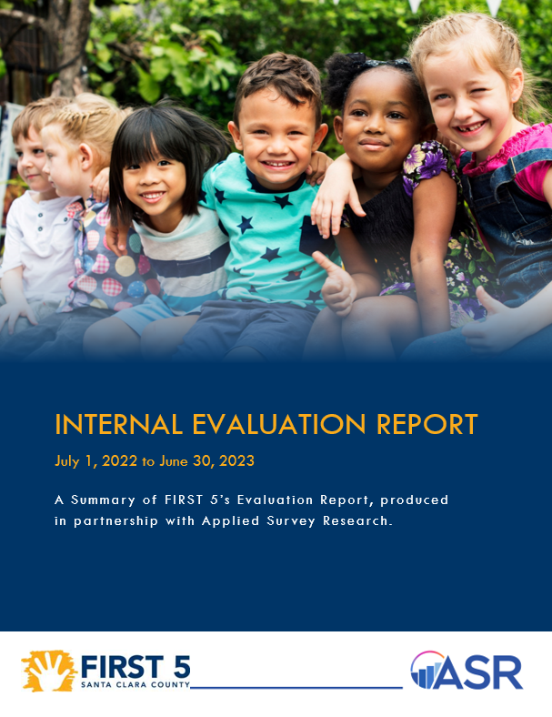
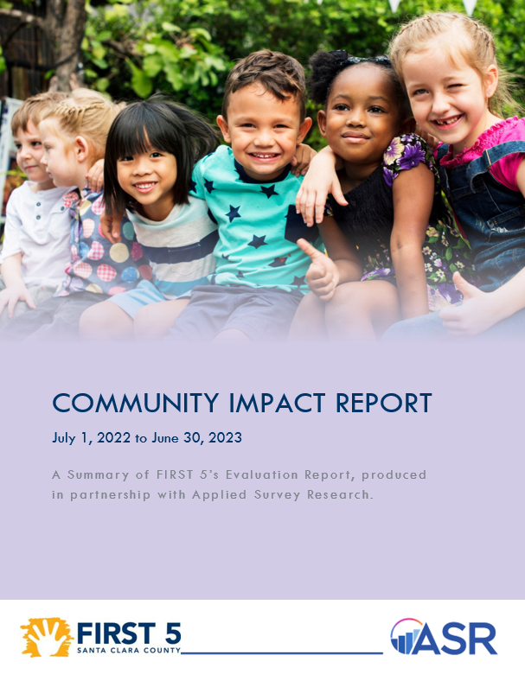
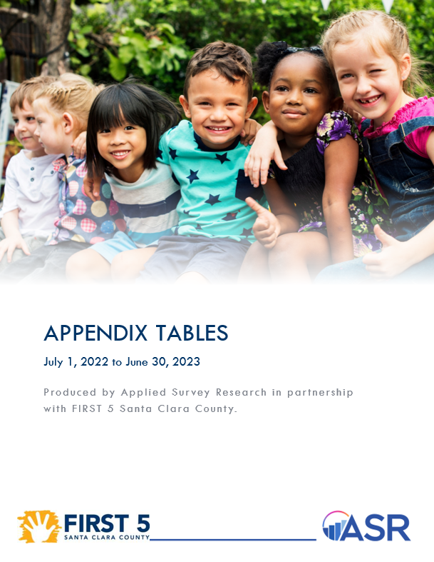
Evaluation Products
Internal Evaluation Report
Community Impact Report
Appendix Tables
This is an internal accountability report to support planning.
Highlights from the last fiscal year to promote on the website.
All program data at your fingertips (Family Intake Form, Exhibit C, Service Agreements, etc.)

Slide 8
Evaluation Framework Results Based Accountability
The first step in RBA is to identify the community results that the organization aims to influence in the community.
FIRST 5’s mission statement serves this purpose by describing the conditions of well-being for children and families in Santa Clara County.
“FIRST 5 Santa Clara County supports the healthy development of children, from prenatal through age five, and enriches the lives of their families and communities.”
Community Result
Notes:
Results Based Accountability (RBA) is an approach that helps program managers and evaluators to create meaningful evaluation plans using a common language that can be accessible to program leads, staff, and participants.
Ultimately, the purpose of RBA is to help you to connect or align your programs to community-level results, to help you visualize how your program is helping to “turn the curve” and making an impact in the community.
The first step in RBA is to identify the community results (sometimes referred to as outcomes or goals) that the organization aims to influence in the community.
FIRST 5’s mission statement serves this purpose by describing the conditions of well-being for children and families in Santa Clara County.

Slide 9
Evaluation Framework Results Based Accountability
Population data illustrate key characteristics for the whole population.
Population data are used to assess how the community is doing with respect to the vision of community health and wellness (FIRST 5’s mission).
Community Result
Population Data
Notes:
Population data illustrates key characteristics for the whole population (e.g., census data, community survey data, etc.). Population data are used to measure progress toward a community result (FIRST 5’s mission).

Slide 10
Evaluation Framework Results Based Accountability
Program data are used to highlight key characteristics of those individuals who participated in a program.
Program data are used to measure how well a program, agency, or service system is working.
HOW MUCH did we do?
HOW WELL did we do it?
Is anybody BETTER OFF as a result?
Community Result
Population Data
Program Data
Equity
Notes:
Program data are used to highlight key characteristics of those individuals who participated in a program (e.g., number of parents participating in a parenting education program, number of children enrolled in Head Start, etc.). Program data are used to measure how well a program, agency, or service system is working.
Throughout the report, program data are highlighted in a callout box to illustrate HOW MUCH the program did, HOW WELL the program did, and whether participants are BETTER OFF.

Slide 11
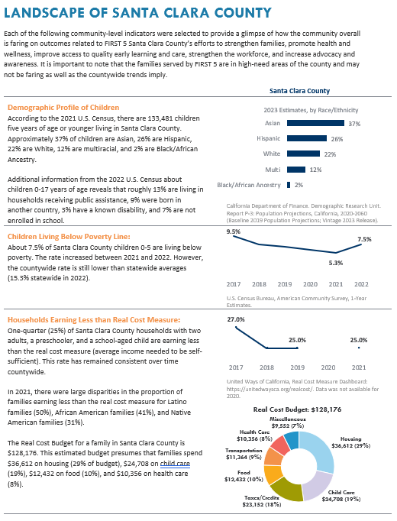
Landscape of Santa Clara County
The Evaluation Report includes a section titled “Landscape of Santa Clara County” to highlight some of the population data that your teams expressed an interest in monitoring.
These population data serve as indicators for the needs of families throughout the county, shedding light on the well-being of children and families in alignment with the priority populations outlined in the new Strategic Plan.

Slide 12
Program Data
The Evaluation Report brings together population data and program data to tell the story of community needs and FIRST 5 programs/efforts to address those needs.
Program data tells the story of how well your programs are doing to meet the needs of families served.
Program measures are outlined in FIRST 5 contracts, service agreements, and program-specific evaluation plans.
HOW MUCH? 3,236 families were served at Family Resource Centers
HOW WELL? 1,512 parents engaged in parenting education workshops
BETTER OFF? Up to 95% of caregivers report increased knowledge and parenting skills

Slide 13
Domains
To better tell the story of integrated efforts across FIRST 5 Santa Clara County internal teams, we restructured the evaluation report around five domains.
Strengthening Families
Strengthening the Workforce
Promoting Health and Wellness
Advocacy and Awareness
Improving Access to Quality Early Learning and Care

Slide 14
Highlights from the Evaluation
Notes:
The Community Report = Executive Summary

Slide 15
Number of Clients Served
Children
Parents/Caregivers
Source: FIRST 5 Santa Clara County AR-1 and AR-2. Note: Direct services are largely unduplicated client counts (core Persimmony clients and aggregate client counts reported by grantees/programs). Community events/drop-in services are duplicated counts (performance measures in Persimmony). Note that children older than six are included in this count of Parents and Caregivers, per First 5 California reporting instructions.

Slide 16
Family Intake Form (FRCs)
In FY 2022-23, 3,236 families completed the Family Intake Forms in FRCs.
Family Concerns
Source: FIRST 5 Santa Clara County, Family Intake Form, FY 2022-23. N = 2,778-2,912. Includes responses where families indicated “A little,” “Moderately,” or “Very much” concerned. Excludes null/missing responses.

Slide 17
Family Intake Form (FRCs)
In FY 2022-23, 3,236 families completed the Family Intake Forms in FRCs.
Service Utilization in Past 6 Months
Source: FIRST 5 Santa Clara County, Family Intake Form, FY 2022-23. N = 3,331.
Source: FIRST 5 Santa Clara County, Child Intake Form, FY 2022-23. N = 3,295.

Slide 18
Strengthening Families

Slide 19
Strengthening Families
FIRST 5 Santa Clara County aims to foster strong and resilient families contributing to the wellbeing of children.
FIRST 5 achieves this by connecting families to local essential services, improving parenting skills, and offering specialized support for justice-impacted families.
Providing Support for Families
Family Resource Center Initiative
Refugee Family Support Services
Family Law Treatment Court
Child Advocates of Silicon Valley
Notes:
The Evaluation Report includes key findings from the FRC initiative, Refugee services, FLTC, and CASA.

Slide 20
Providing Support for Families
Family Resource Centers (FRCs) empowered parents/caregivers with essential services and supports.
HOW MUCH? 3,236 families were served at Family Resource Centers
HOW WELL? 1,512 parents engaged in parenting education workshops
Note: One circle represents 20 people.

Slide 21
Providing Support for Families
Family Resource Centers (FRCs) empowered parents/caregivers with essential services and supports.
Increased Knowledge/Skills
BETTER OFF? Up to 95% of caregivers report increased knowledge and parenting skills
Source: FIRST 5 Santa Clara County, Retrospective Pre/Post Survey for each Workshop, FY 2022-23. Scale is from 1 to 5 (Low to High) and the percentages shown in the charts above reflect responses where the parent indicated a rating of 4 or 5 (Moderate to High) confidence or competency.

Slide 22
Additional Efforts
Refugee Family Support Services, to support families resettling in California. Aid provided for housing, childcare, mental health, legal support, supplies, and other services to meet basic needs. Support was rendered by International Rescue Committee and Asian Americans for Community Involvement
HOW MUCH? 130 individuals were served by the Refugee Family Support Services programs
HOW WELL? 48% of individuals received service coordination and language support
Family Law Treatment Court, which connects participants in the FLTC program with Resource Specialists to strengthen parent-child relationships and promote family cohesion.
HOW MUCH? 35 parents and 68 children were served
HOW WELL? 32 children had 6 or more visits
BETTER OFF? 37% of FLTC participants with court granted visits had increased visitation over the past year
CASA of Silicon Valley, connects court-appointed advocates with children who are involved in the dependency system.
HOW MUCH? 112 children 0-5 in the dependency system were supported by an advocate.
HOW WELL? 99% reported positive experiences by connecting with a CASA
BETTER OFF? 64% of CASA-served children received support for childhood trauma
Notes:
Emily? With support from Evelyn? ASR?

Slide 23
Promoting Health and Wellness

Slide 24
Promoting Health and Wellness
FIRST 5 Santa Clara County invests in a variety of home visiting programs, health and developmental screenings, and early intervention services.
The goal is to ensure that children are born healthy, and have the opportunity to experience optimal physical, behavioral, and developmental health.
Identifying Health and Development Needs
Universal Developmental Screening and Early Intervention
Developmental Behavioral Pediatric Clinics
Home Visiting Systems Coordination
CalWORKs Home Visiting Program
ParentChild+ Home Visitation Program
County of Santa Clara Public Health Department
Notes:
Kelsey
The Evaluation Report includes key findings from…

Slide 25
Identifying Health and Development Needs
Children received health and developmental screenings.
HOW MUCH? 28,344 health and developmental screenings were conducted across the county
HOW WELL? 1,055 children were served at KCN
BETTER OFF? 60% of children served at KCN are meeting more of their developmental milestones at follow-up screenings
Source: Healthier Kids Foundation FY 2022-23 (physical screens), FIRST 5 Santa Clara County FY 2022-23 (developmental ASQ-3 and behavioral ASQ-SE2 screens).
Notes:
Kelsey

Slide 26
Identifying Health and Development Needs
Children received health and developmental screenings.
Developmental Screenings and Referrals in FRCs
Developmental Screenings and Referrals by PHNs
Source: FIRST 5 Santa Clara County Baseline and Follow-up Assessments for ASQ-3, FY 2022-23. Child counts may be duplicated for those children who are screened multiple times during the year (e.g., monitor and re-screen at baseline and referred to KCN at follow-up).
Source: FIRST 5 Santa Clara County Baseline and Follow-up Assessments for ASQ-3, FY 2022-23. Child counts may be duplicated for those children who are screened multiple times during the year (e.g., monitor and re-screen at baseline and referred to KCN at follow-up). No ASQ-SE2 referral data available.
Notes:
Nishma and Kelsey
“Other referral sources” are largely unknown for FY 2022-23.
New list in ASQ Online to capture “other” referral sources (i.e., early start, school district, regional center, other, or indicate if already receiving services)

Slide 27
Additional Efforts
Developmental Behavioral Pediatric Clinic, provides pediatric developmental services at various ambulatory clinic sites throughout Santa Clara County (high quality assessments; care coordination; direct referrals and linkages).
HOW MUCH? 406 children served and 324 Medi-Cal recipients
HOW WELL? 128 children were referred to KCN/Early Start
CalWORKs Home Visiting Program, supports positive health development and well-being outcomes for pregnant and parenting people, families, and infants born into poverty expand their future educational, economic, and financial capability opportunities.
HOW MUCH? 141 parents and their children participated in 887 home visits
HOW WELL? 45 CalWORKs HVP participants (duplicated) were referred to services
BETTER OFF? 30 CalWORKs HVP participants (duplicated) were successfully connected to other services
Public Health Nursing Home Visiting Program, provides home visiting services with a public health nurse to support screening, health education, and connect families to services.
HOW MUCH? 150 children birth to age 5 were engaged in home visiting services with a PHN
HOW WELL? 80 children and their caregivers were referred to their local FIRST 5 FRC for support
BETTER OFF? 28 out of 30 children exited the program with a medical home

Slide 28
Improving Access to Quality Early Learning and Care

Slide 29
Improving Access to Quality Early Learning and Care
FIRST 5 Santa Clara County is committed to ensuring high-quality early education for all children, addressing their academic, physical, and social-emotional needs. Access to quality early learning and care will prepare children to be lifelong learners at home, school, and in their communities.
Community-building and Support for Providers
QUALITY MATTERS…a STRONG START for kids
San Jose Public Library Family, Friend and Neighbor Caregiver Support Network
Financial Support for Family Child Care Home Providers
Santa Clara County Office of Education Inclusion Collaborative
Inclusion Collaborative Warmline
SEEDS of Learning
Teachstone
Notes:
The Evaluation Report includes key findings from…

Slide 30
Community-building for Providers
QUALITY MATTERS reached 661 early education sites in 2022-23.
Participating Sites
Children Served
HOW MUCH? 661 early learning providers engaged in QUALITY MATTERS 10,836 children benefited from being in the care of a QUALITY MATTERS provider
Source: FIRST 5 Santa Clara County, Common Data File, FY 2022-23; retrieved from Hubbe database.

Slide 31
Community-building for Providers
QUALITY MATTERS reached 661 early education sites in 2022-23.
Children
HOW MUCH? 661 early learning providers engaged in QUALITY MATTERS 10,836 children benefited from being in the care of a QUALITY MATTERS provider
Source: FIRST 5 Santa Clara County, Common Data File, FY 2022-23; retrieved from Hubbe database.

Slide 32
Additional Efforts
Inclusion Collaborative Warm Line, provides families and early educators with free support, information, and referral service regarding the inclusion of children with developmental needs and disabilities in the community.
HOW MUCH? 1,087 people were supported by the Warmline
HOW WELL? 3,338 services were provided to support caregivers and children
SEEDS of Learning, a professional development program for educators, to help the children in their care develop the early literacy skills and the social-emotional foundation they need to be ready for kindergarten.
HOW MUCH? 70 early educators participated in SEEDS
HOW WELL? 45 providers utilize the Child/Home Early Language and Literacy Observation Tool to understand development of children served
BETTER OFF? 62% of SEEDS providers received a rating of Excellent on the CHELLO Assessment at post-test.
Family, Friend and Neighbor Caregiver Support, a professional development curriculum offered through the San José Public Library (SJPL) to share resources with caregivers who were interested in learning more about child development for those in their care.
HOW MUCH? 121 Family, Friend, and Neighbor caregivers reached
HOW WELL? 75% completed 21 professional development hours

Slide 33
Strengthening the Workforce

Slide 34
Strengthening the Workforce
FIRST 5 Santa Clara County aims to strengthen workforce pipelines and career advancement opportunities for those who directly serve families with children from prenatal stages to age five.
They focus on creating a skilled and diverse workforce and offer child-focused professional development opportunities.
Supporting Early Educators and Providers
Santa Clara County Early Learning Workforce Initiatives
Workshops and Trainings for Providers
Notes:
The Evaluation Report includes key findings from…

Slide 35
Training for Providers
Over 600 providers attended trainings to learn more about helping families understand healthy development.
HOW MUCH? 612 providers attended trainings through FIRST 5
Source: FIRST 5 Santa Clara County, Community of Learning, FY 2022-23.

Slide 36
Additional Efforts
Early Learning Apprenticeship Program, an equity-oriented workforce initiative, focused on bringing a diverse set of individuals into the field of early learning and care offering paid on-the-job training, no-cost college courses, and cohort learning at community-based locations.
HOW MUCH? 51 apprentices participated in the program, serving 565 children
HOW WELL? 98% of apprentices report that they have increased knowledge of early care and education
Shared Services Alliance, incentivized, prepared, and supported Family Child Care Home Providers (FCCH) to meet demand for quality early learning and care by developing and implementing shared services.
HOW MUCH? 37 FCCH providers recruited to the Design Team, serving 274 children
HOW WELL? Providers identified the top 5 pedagogical needs/priorities for the year ahead: - Retirement - Health insurance - Market Rate Increase - Bus. Management - Facility Expansion

Slide 37
Questions?

